Slide 1

Deloitte Pre Hire Training 2017
FOUNDATION TRAINING
Spring Core

Slide 2
Core Spring
Aspect Oriented Programming

Slide 3
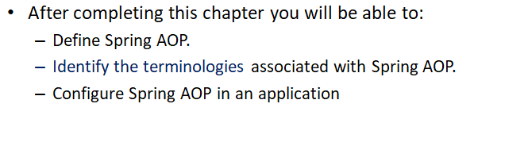
Objectives

Slide 4
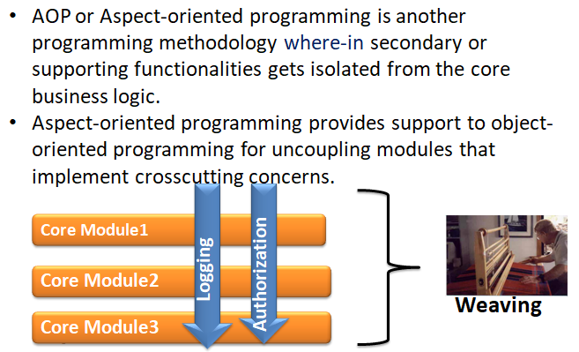
Spring AOP

Slide 5
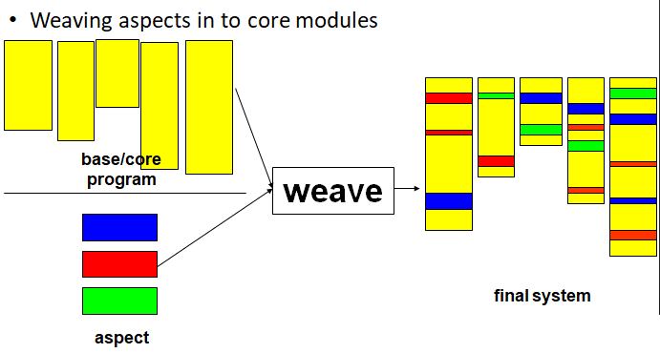
Weaving

Slide 6
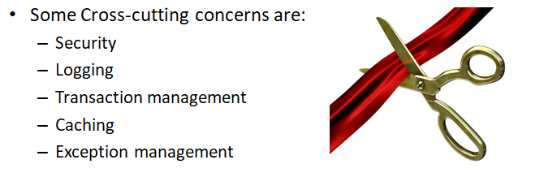
Cross-Cutting Functionalities

Slide 7
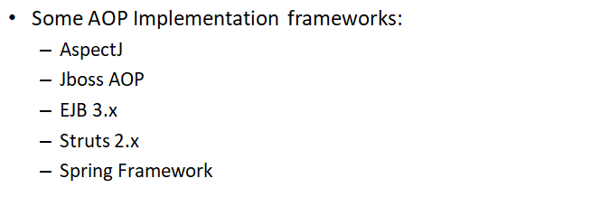
AOP Implementation

Slide 8
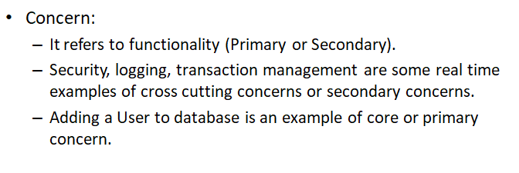
AOP : Terminologies

Slide 9
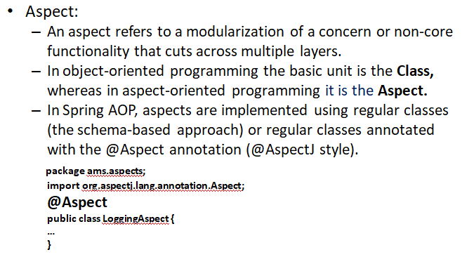
AOP : Terminologies

Slide 10
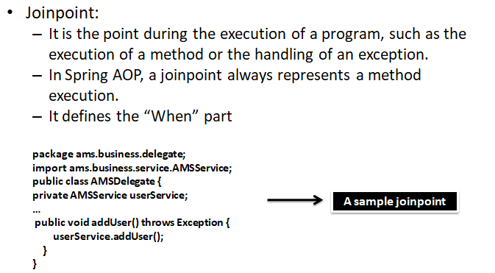
AOP : Terminologies

Slide 11
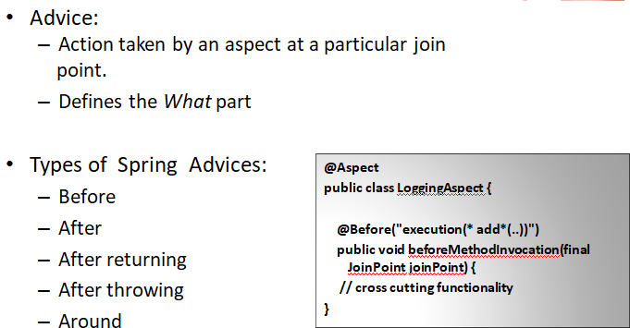
AOP : Terminologies

Slide 12
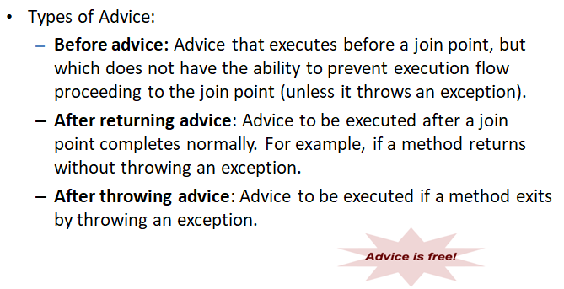
AOP : Terminologies

Slide 13
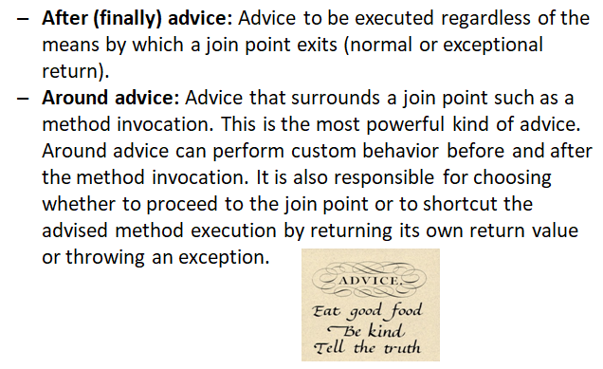
AOP : Terminologies

Slide 14
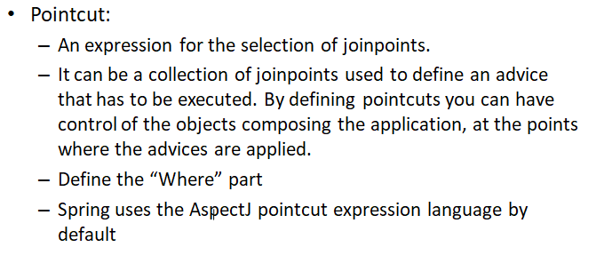
AOP : Terminologies

Slide 15
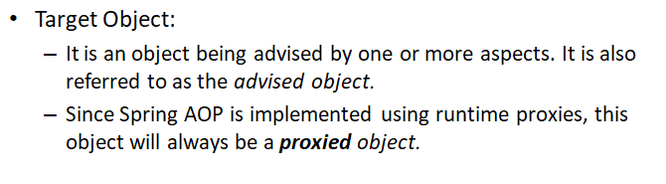
AOP : Terminologies

Slide 16
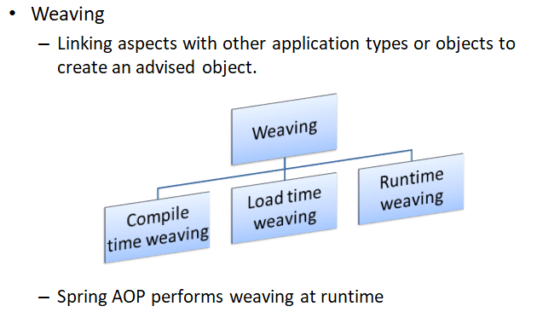
AOP : Terminologies

Slide 17
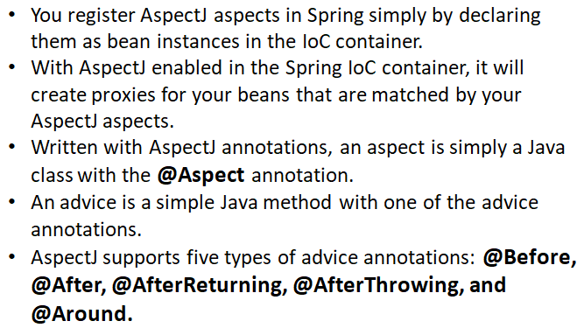
Declaring Aspects with AspectJ Annotations

Slide 18
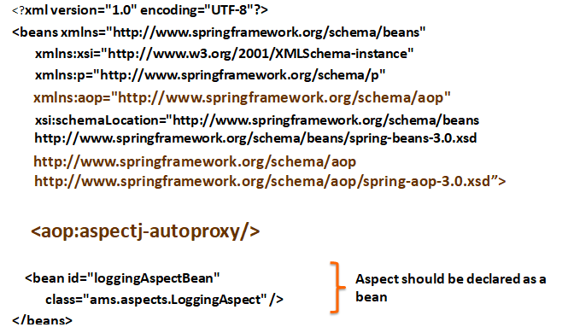
Declaring Aspects with AspectJ Annotations

Slide 19
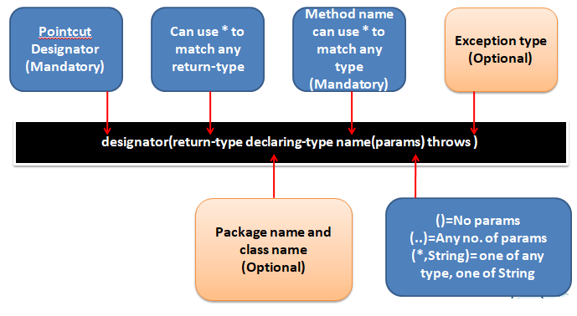
Pointcut Expression Pattern

Slide 20
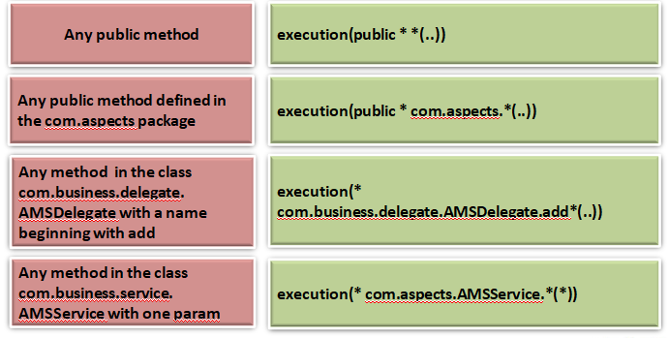
Pointcut Expression Example

Slide 21
Demo
Write a simple code explaining the AOP

Slide 22
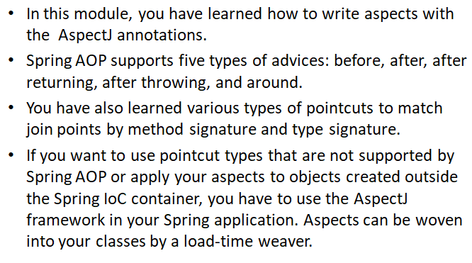
Summary

